Slide 1
VIETNAM HISTORY

Slide 2



OBJECT-ORIENTED-PROGRAMMING
Developing an app about the history of Vietnam.
Group 1

Slide 3
CHAPTER 1: INTRODUCTION
Team’s members
Student’s name | Student’s ID
Nguyen Trong Huy | 20210451
Bui Phuong Nam | 20215227
Tran Duc Nam | 20215228
Trinh Giang Nam | 20215229
Nguyen Chinh Minh | 20215224
Hoang Minh Quan | 20215236

Slide 4
CHAPTER 2: PROBLEM DESCRIPTION
I. Study Case
There are numerous websites that provide information about the history of Vietnam. The task is to search and automatically gather data about the history of Vietnam from these websites and interlink the collected data
The entities to be collected include:
Historical dynasties of Vietnam
Historical figures of Vietnam
Tourist destinations and historical landmarks
Cultural festivals
Historical events in Vietnam
Each entity needs to have an identifier and various attributes. Importantly, the entities should be interconnected.
For the final version of your application, the collected data needs to be stored in either JSON or CSV format. Subsequently, provide search functionality and display information for end users.

Slide 5
CHAPTER 2: PROBLEM DESCRIPTION
II. Problem Solving Strategies
Stage | Desciption | Period
Requirement Analysis | - Analyse the requirement of the study case. - Feature the specific functionality that the system should have. - Examine the websites that are helpful for data crawling. - Study the process to crawl data from a website | 3-4 days
Design | - System design - Program design | 1 week
Implementation | - Coding - GUI implementation | 3 weeks
Integration & Testing | - Integrate each component of system - Mannual Testing | 4-5 days
Release | - Deliver final report, source code, etc. - Presentation & demo video | -

Slide 6
CHAPTER 2: PROBLEM DESCRIPTION
II. Technologies, Frameworks, Libraries in use
Tools | Objectives
E(fx)clipse Windows 64 bits | IDE
GitHub | Version Control
Asana | Project Management
SceneBuilder | GUI design
Java | Programming Language
Maven Project | Java library management tool
Astah | UML design tool

Slide 7
CHAPTER 2: PROBLEM DESCRIPTION
II. Problem Solving Strategies
Library | Version | Description
JDK | 19.0.0 | Java core library
gson | 2.9.0 | Converting Java objects to JSON
json-simple | 1.1.1 | Parsing and generating JSON
jsoup | 1.15.3 | Web scraping and HTML parsing
json | 20220320 | A lightweight data interchange format
javaFX | 16 | GUI coding (event handling, …)

Slide 8
CHAPTER 3: REQUIREMENT ANALYSIS
I. Base data Specification
Entity | Attribute | Description
Thời kỳ (Dynasties) | Tên (Name) | This entity depicts all dynasties of Viet Nam History
 | Kinh đô (Capital)
 | Các đời vua (Kings)
 | Người sáng lập (Founder)
 | Thời gian tồn tại (Period)
 | Quốc hiệu (Nation’s name)
Nhân vật lịch sử (Figures) | Tên (Name) | This entity lists all Vietnamese historical figures, which may also include Vua (King)
 | Năm sinh (Year of birth)
 | Năm mất (Year of death)
 | Quê quán (Hometown)
 | Thời kỳ (Dynasty)
Sự kiện lịch sử (Events) | Tên (Name) | This concept shows information of Vietnamese historical events. This also includes Chiến Tranh (Vietnamese War)
 | Thời gian (Period)
 | Thời kỳ (Dynasty)
 | Nhân vật liên quan (Figure)
 | Nội dung (Content)
Lễ hội (Festivals) | Tên (Name) | Describe Vietnamese historical festivals
 | Thời gian (Period)
 | Địa điểm (Place)
 | Nhân vật liên quan (Figure)
Di tích (Relics) | Tên (Name) | List all Vietnamese relics
 | Địa điểm (Place)
 | Loại di tích (Classification)
 | Năm (Year of recognition)
 | Nhân vật liên quan (Figure)

Slide 9
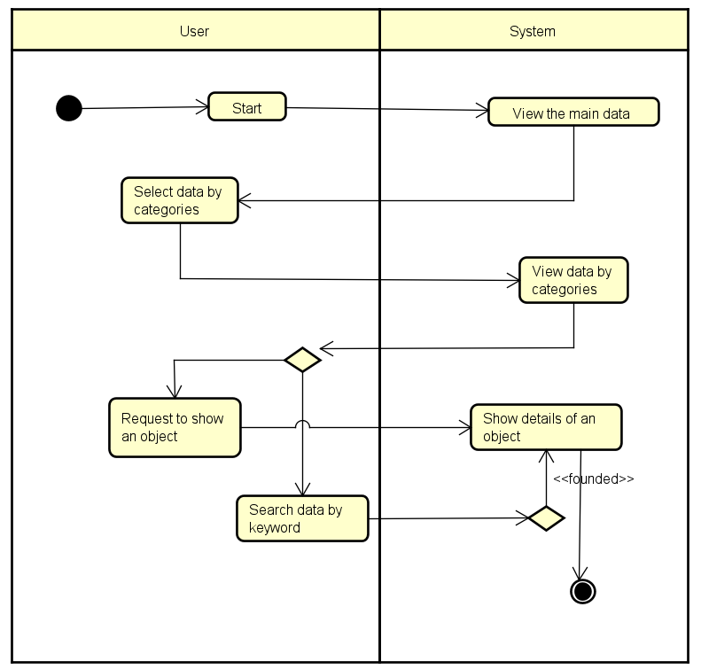
CHAPTER 3: REQUIREMENT ANALYSIS
II. Business process analysis
1. Data searching process activity diagram

Slide 10
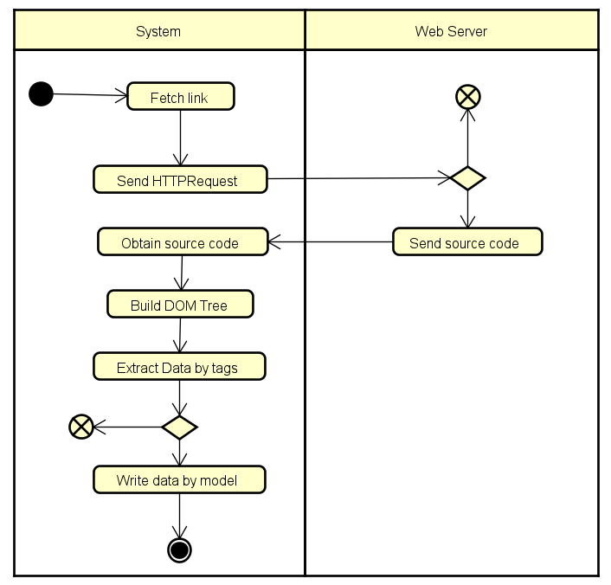
CHAPTER 3: REQUIREMENT ANALYSIS
II. Business process analysis
2. Web scraping process activity diagram

Slide 11
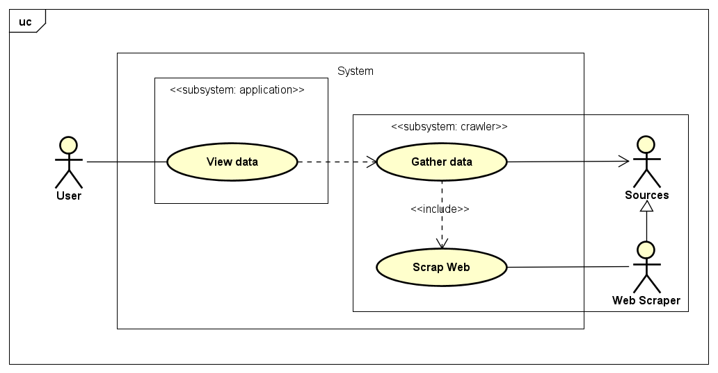
CHAPTER 3: REQUIREMENT ANALYSIS
III. Use case diagram

Slide 12
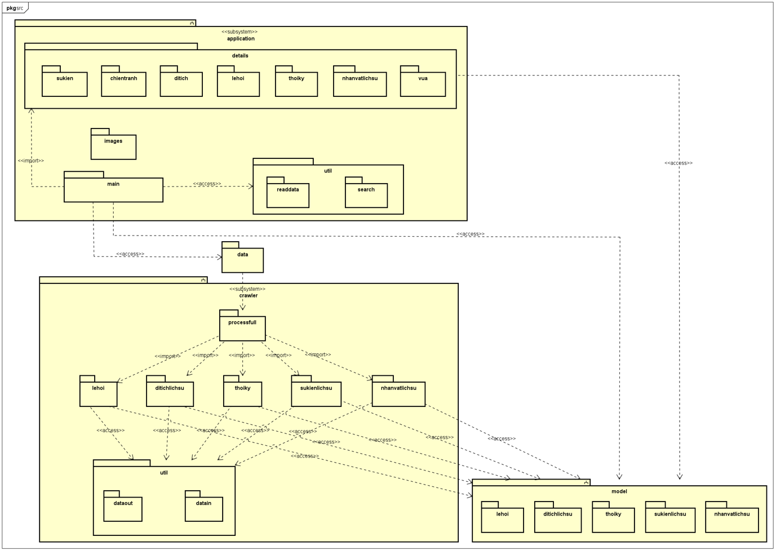
CHAPTER 4: DESIGN ANALYSIS
I. System Design: Package diagram

Slide 13
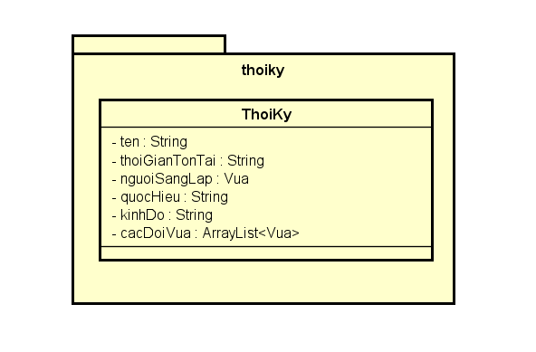
CHAPTER 4: DESIGN ANALYSIS
II. Program Design: Class diagram
1. Package “model”
1.1. Package thoiky

Slide 14
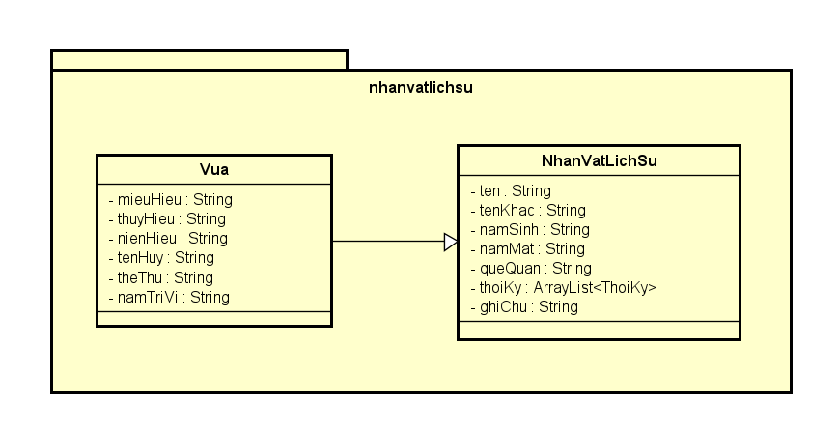
CHAPTER 4: DESIGN ANALYSIS
II. Program Design: Class diagram
1. Package “model”
1.2. Package nhanvatlichsu

Slide 15
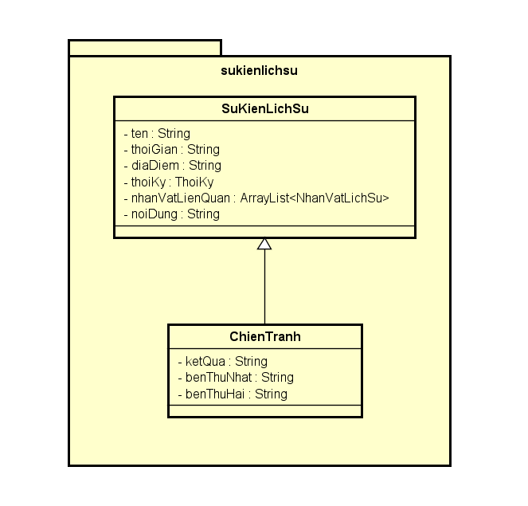
CHAPTER 4: DESIGN ANALYSIS
II. Program Design: Class diagram
1. Package “model”
1.3. Package sukienlichsu

Slide 16
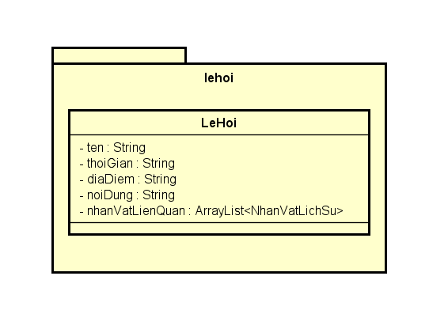
CHAPTER 4: DESIGN ANALYSIS
II. Program Design: Class diagram
1. Package “model”
1.4. Package lehoi

Slide 17
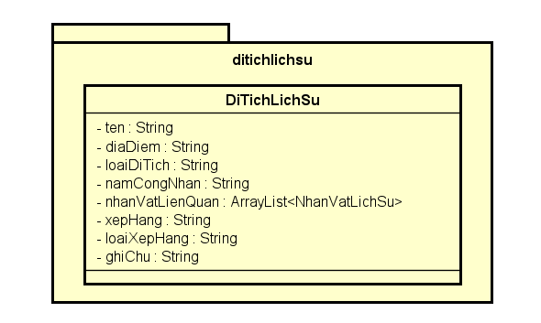
CHAPTER 4: DESIGN ANALYSIS
II. Program Design: Class diagram
1. Package “model”
1.5. Package ditichlichsu

Slide 18
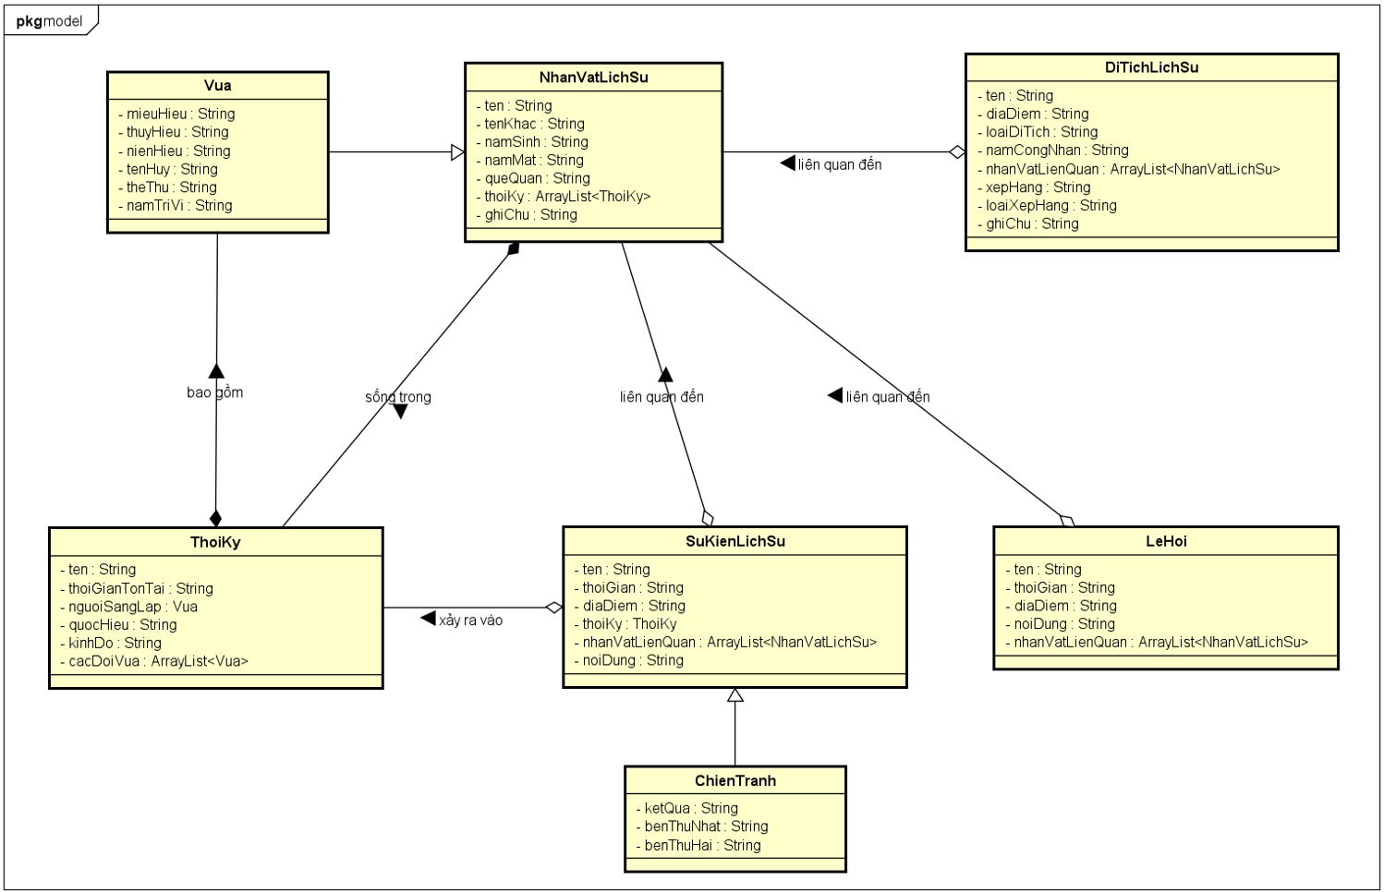
CHAPTER 4: DESIGN ANALYSIS
II. Program Design: Class diagram
1. Package “model”

Slide 19
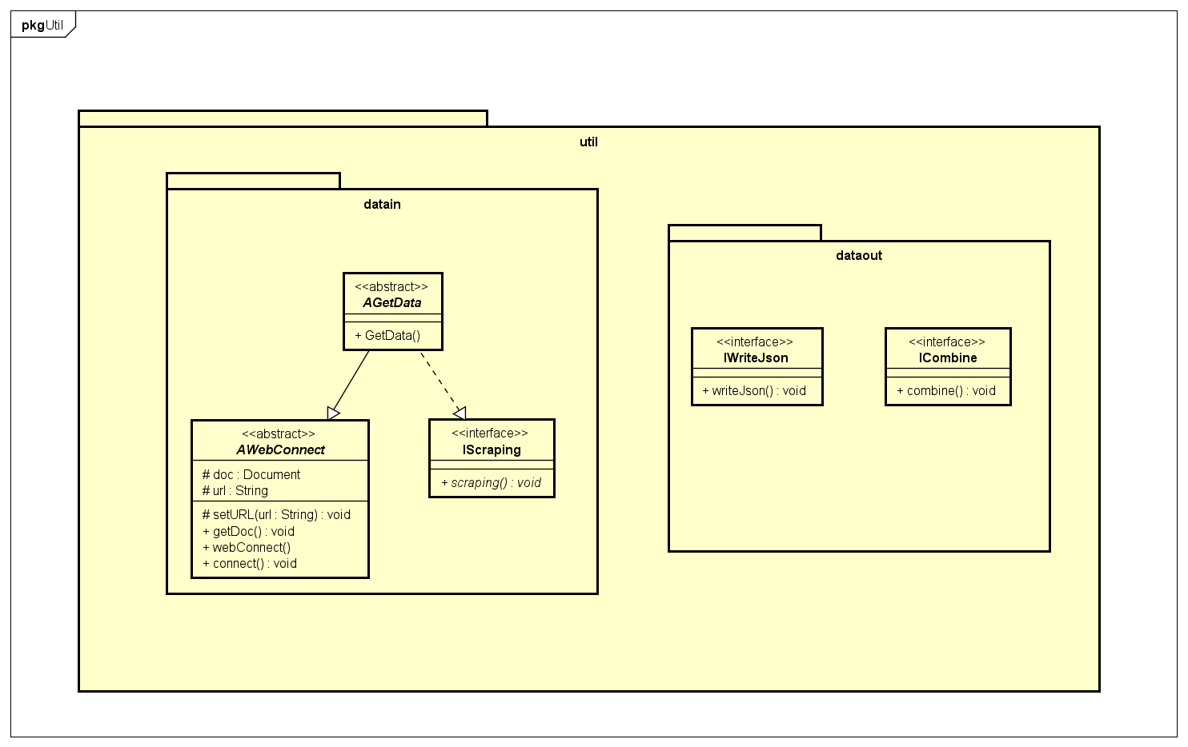
CHAPTER 4: DESIGN ANALYSIS
II. Program Design: Class diagram
2. Package “crawler”
2.1. Package crawler.util

Slide 20
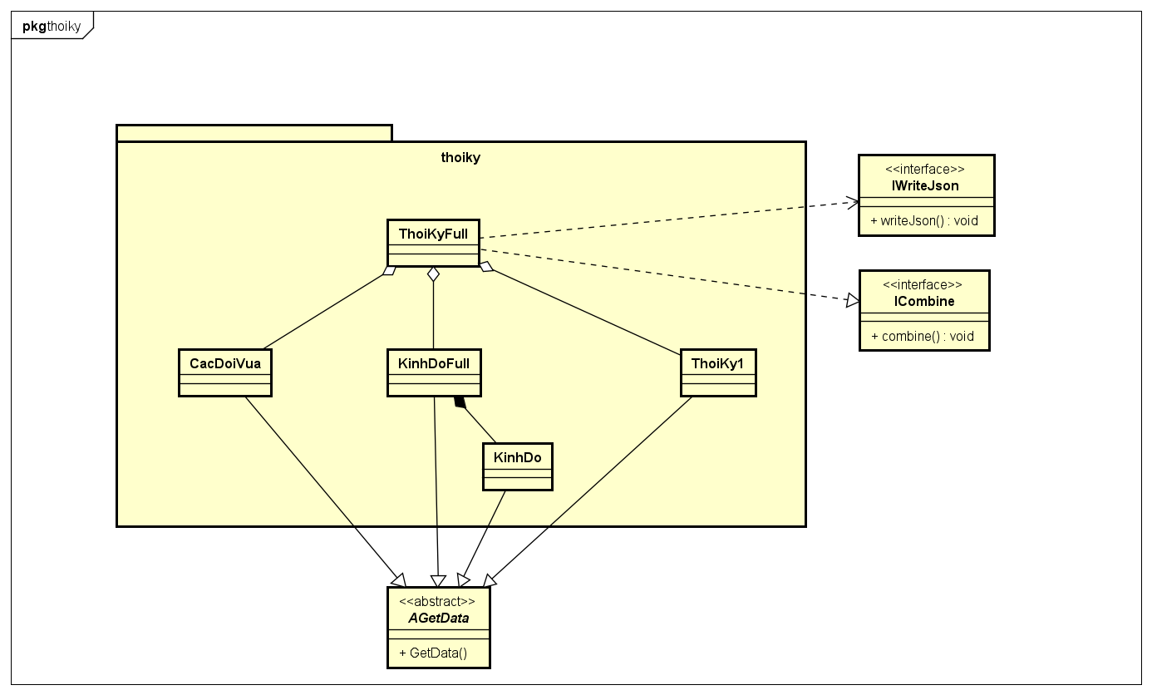
CHAPTER 4: DESIGN ANALYSIS
II. Program Design: Class diagram
2. Package “crawler”
2.2. Package crawler.thoiky

Slide 21
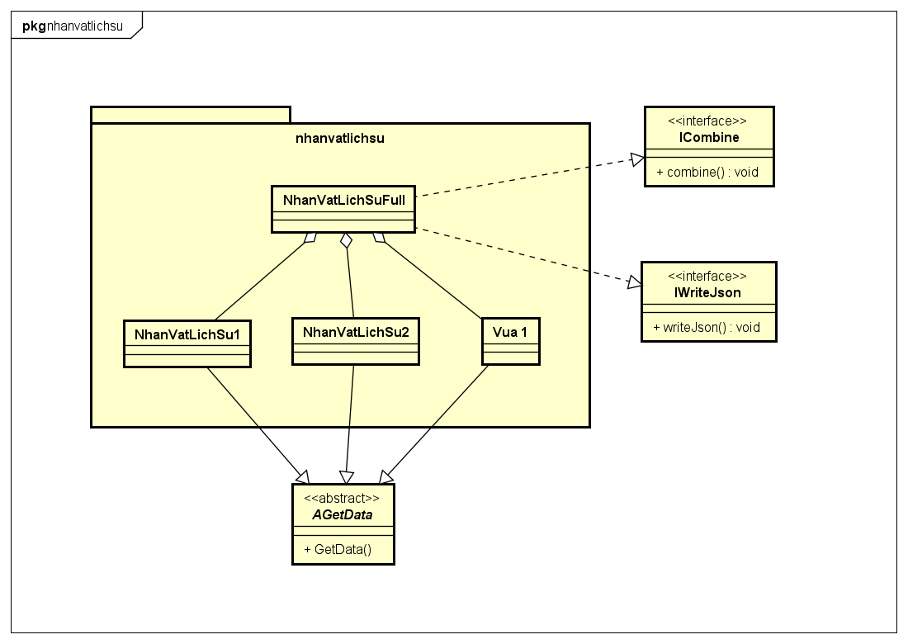
CHAPTER 4: DESIGN ANALYSIS
II. Program Design: Class diagram
2. Package “crawler”
2.3. Package crawler.nhanvatlichsu

Slide 22
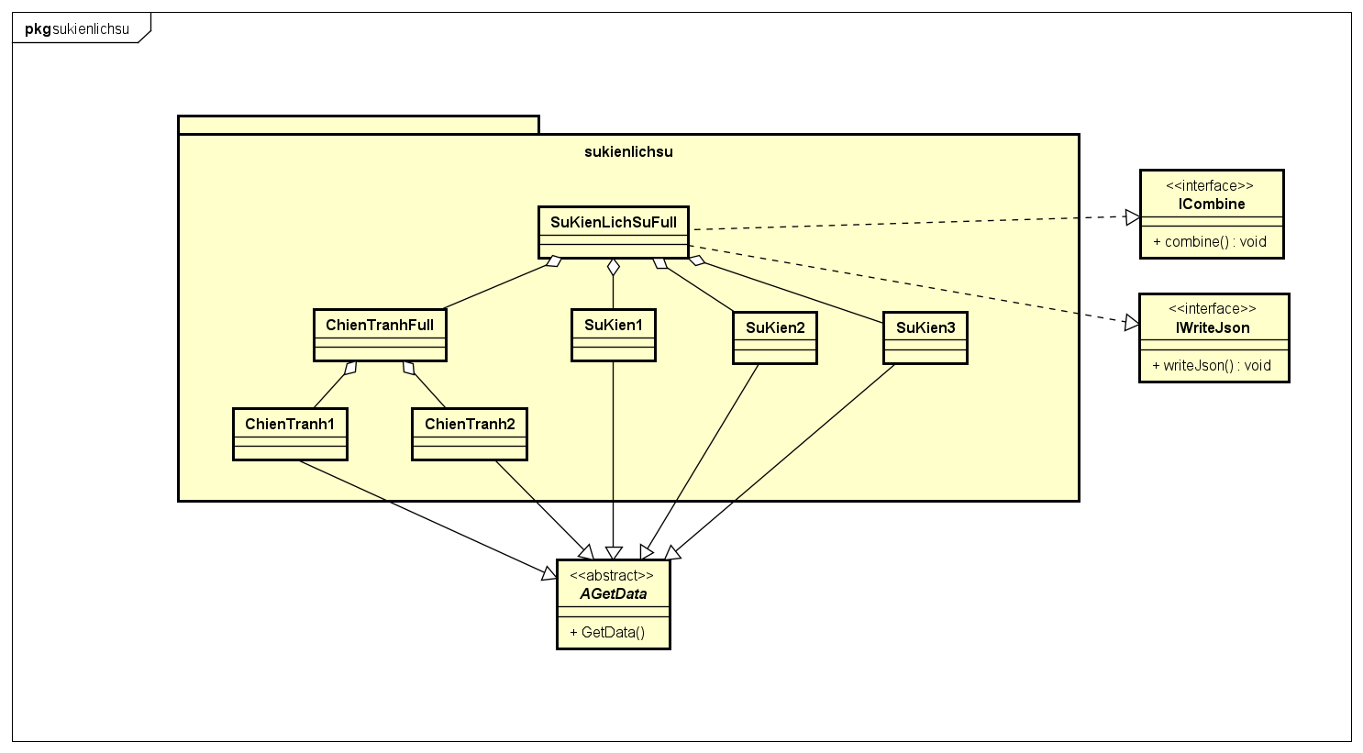
CHAPTER 4: DESIGN ANALYSIS
II. Program Design: Class diagram
2. Package “crawler”
2.4. Package crawler.sukienlichsu

Slide 23
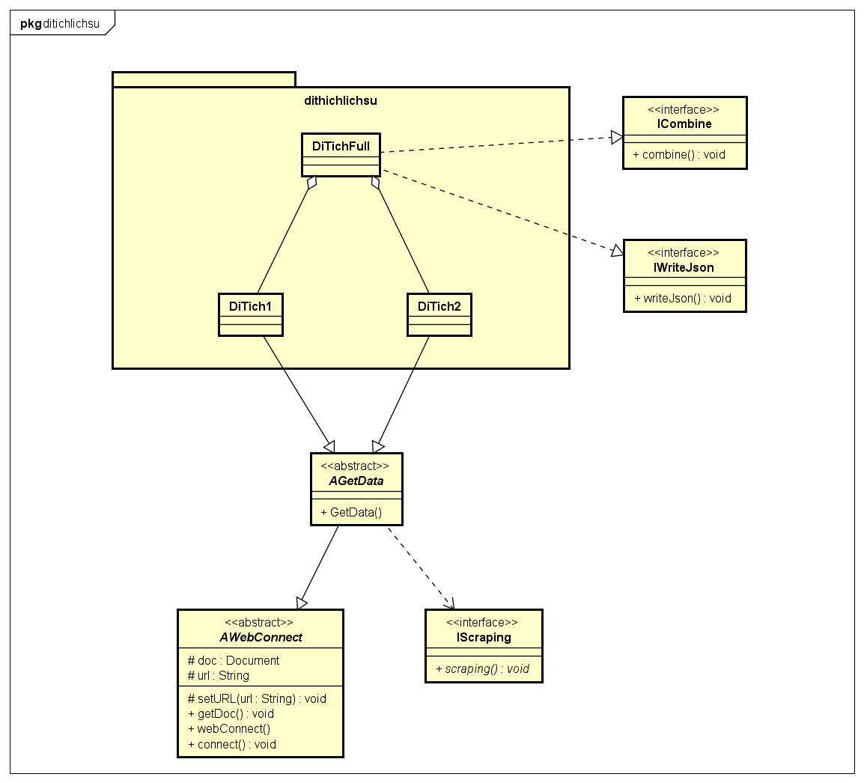
CHAPTER 4: DESIGN ANALYSIS
II. Program Design: Class diagram
2. Package “crawler”
2.5. Package crawler.ditichlichsu

Slide 24
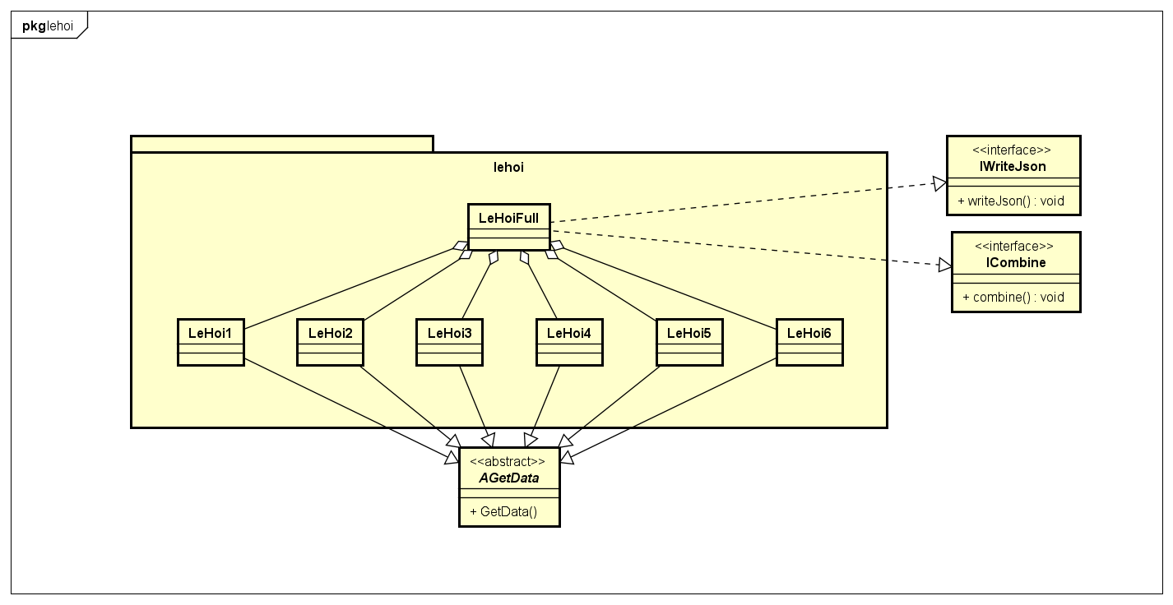
CHAPTER 4: DESIGN ANALYSIS
II. Program Design: Class diagram
2. Package “crawler”
2.6. Package crawler.lehoi

Slide 25
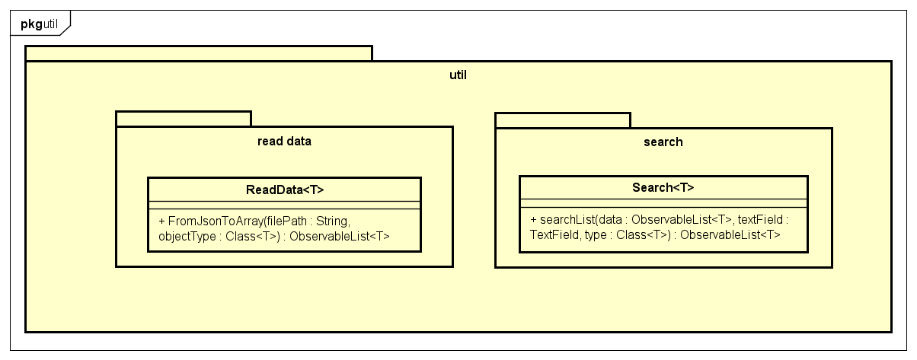
CHAPTER 4: DESIGN ANALYSIS
II. Program Design: Class diagram
3. Package “application”
3.1. Package application.util

Slide 26
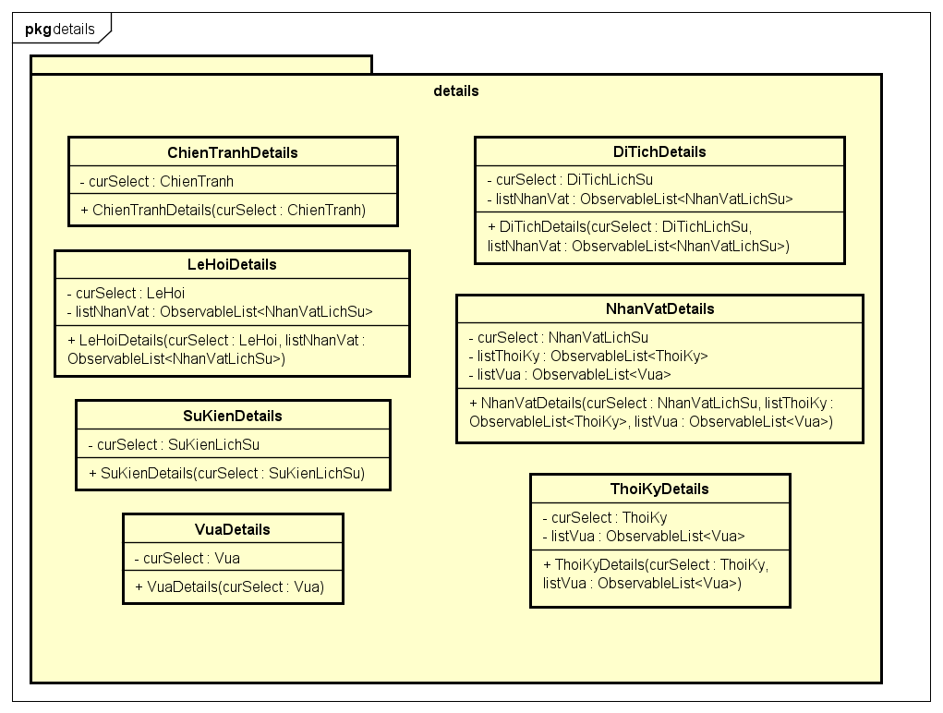
CHAPTER 4: DESIGN ANALYSIS
II. Program Design: Class diagram
3. Package “application”
3.2. Package application.details

Slide 27
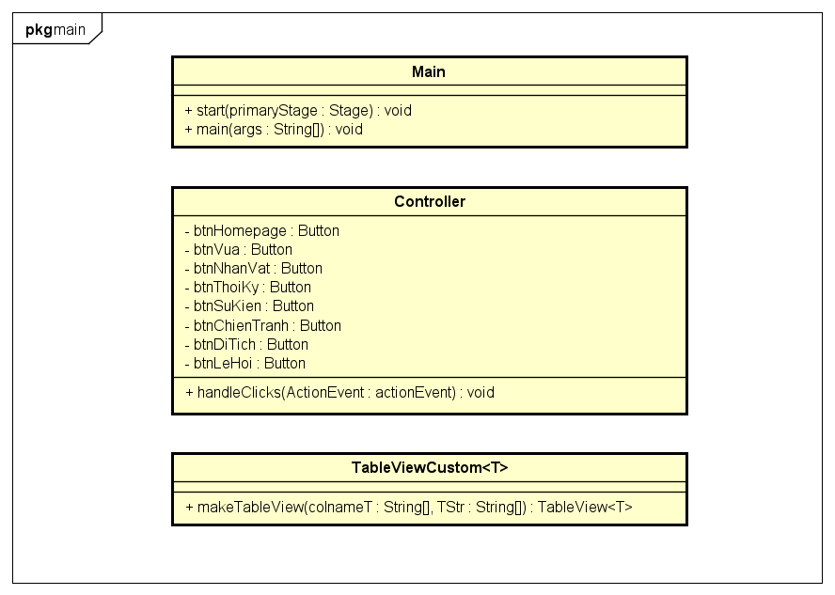
CHAPTER 4: DESIGN ANALYSIS
II. Program Design: Class diagram
3. Package “application”
3.2. Package application.main

Slide 28
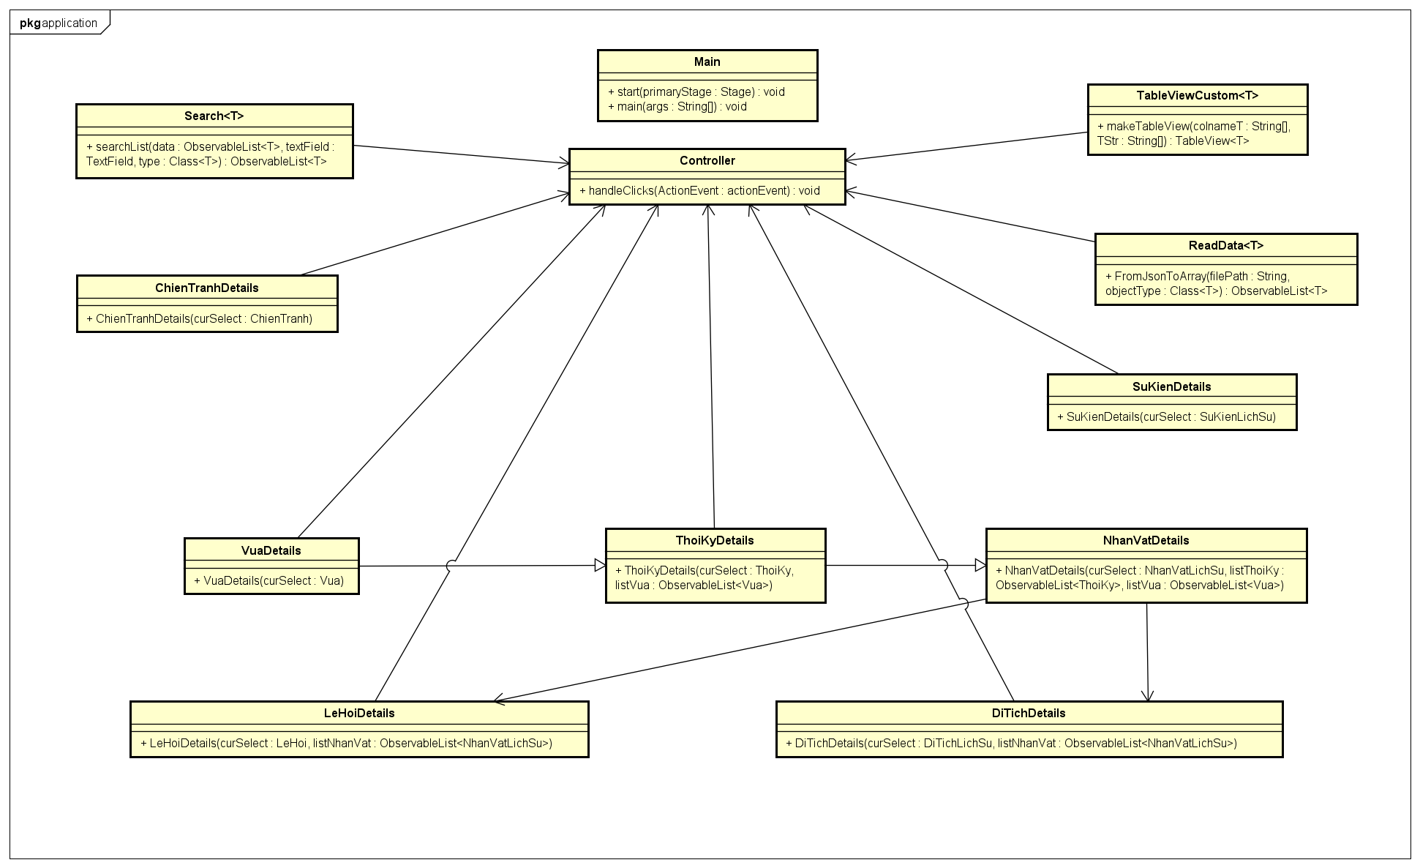
CHAPTER 4: DESIGN ANALYSIS
II. Program Design: Class diagram
3. Package “application”

Slide 29
CHAPTER 4: DESIGN ANALYSIS
II. Program Design: Class diagram
4. Data storing design
Json files | Objectives | Folder
thoiKy.json | stores dynasty data | 3-4 days
ChienTranh.json | stores war data | data.sukienlichsu
SuKien.json | stores historical event data
nhanVatLichSu.json | stores historical figure data | data.nhanvatlichsu
vua.json | stores kings data
DiTich.json | stores historical relic data | data.ditichlichsu
leHoi.json | stores festival data | data.lehoi

Slide 30
CHAPTER 5. RESULTS & PROGRAM TESTING
I. Statistics of data
Entites | Quantity
Dynasty (Thời kỳ) | 22
Historical figure (Nhân vật lịch sử) | 2368
King (Vua) | 164
Historical event (Sự kiện lịch sử) | 345
War (Chiến tranh) | 283
Relic (Di tích lịch sử) | 5684
Festival (Lễ hội) | 318

Slide 31
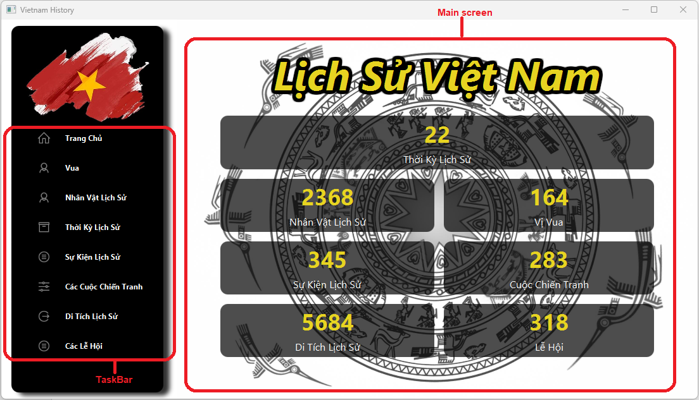
CHAPTER 5. RESULTS & PROGRAM TESTING
II. Final program testing
Main screen (Trang chủ)

Slide 32
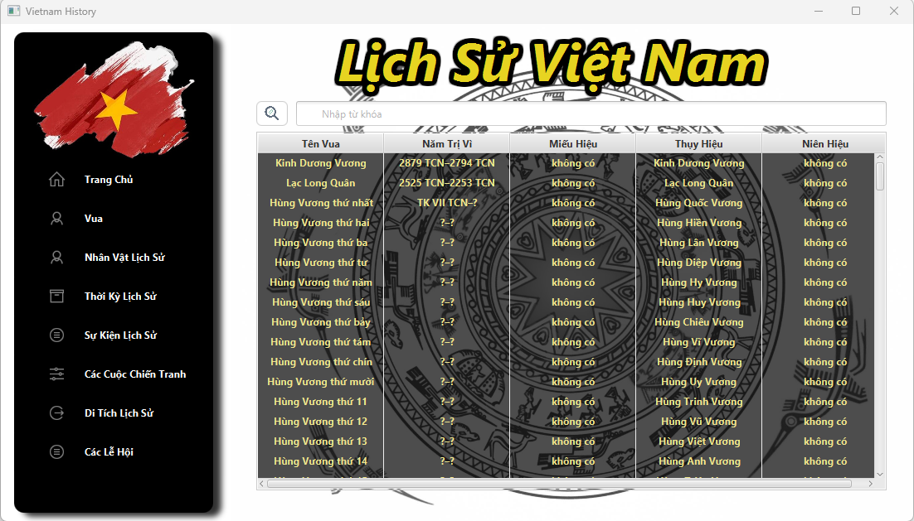
CHAPTER 5. RESULTS & PROGRAM TESTING
II. Final program testing
King screen (Vua)

Slide 33
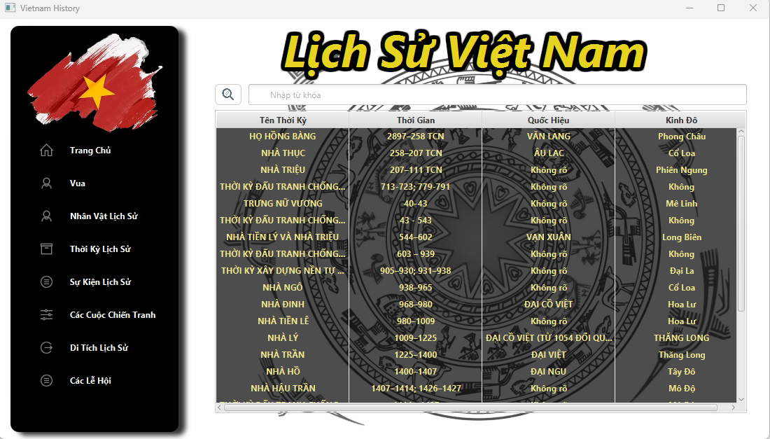
CHAPTER 5. RESULTS & PROGRAM TESTING
II. Final program testing
Dynasty screen (Thời kỳ lịch sử)

Slide 34
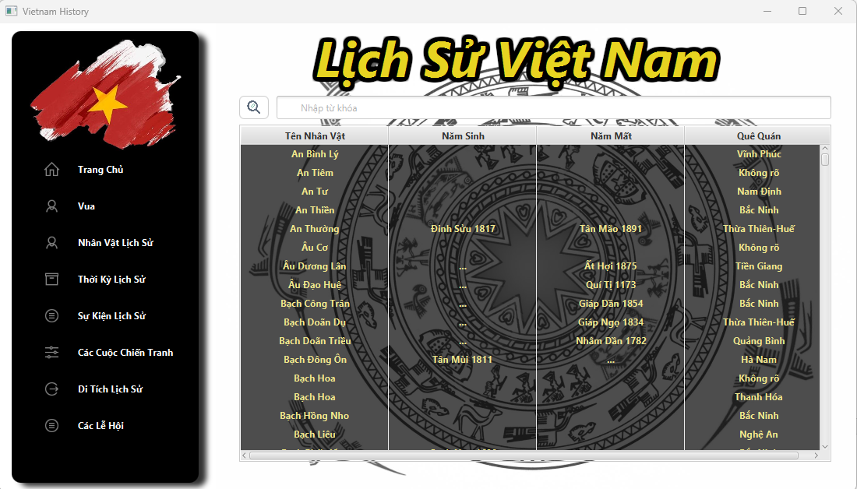
CHAPTER 5. RESULTS & PROGRAM TESTING
II. Final program testing
Historical figure screen (Nhân vật lịch sử)

Slide 35
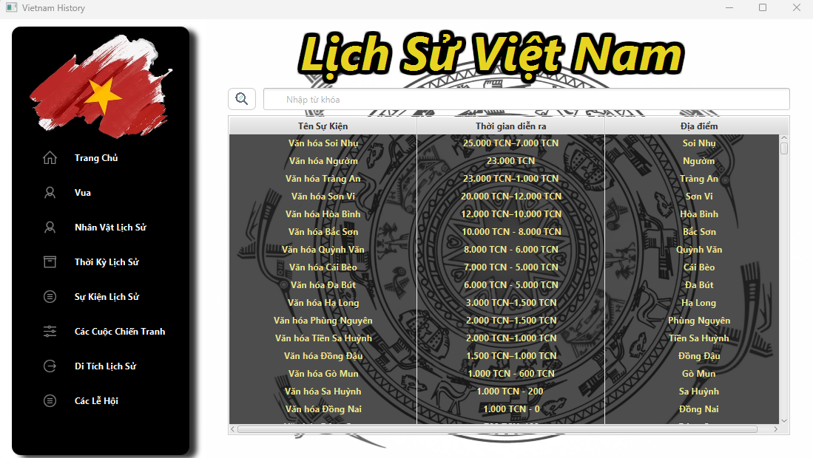
CHAPTER 5. RESULTS & PROGRAM TESTING
II. Final program testing
Event screen (Sự kiện lịch sử)

Slide 36
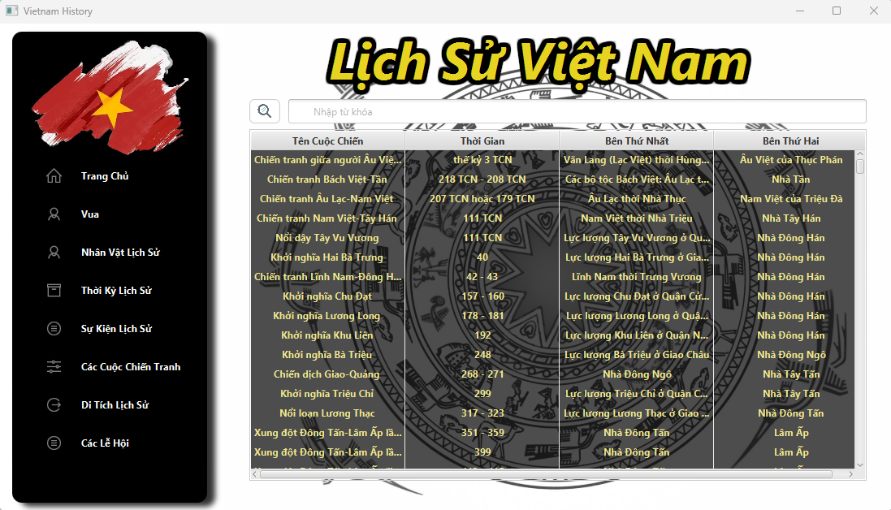
CHAPTER 5. RESULTS & PROGRAM TESTING
II. Final program testing
War screen (Các cuộc chiến tranh)

Slide 37
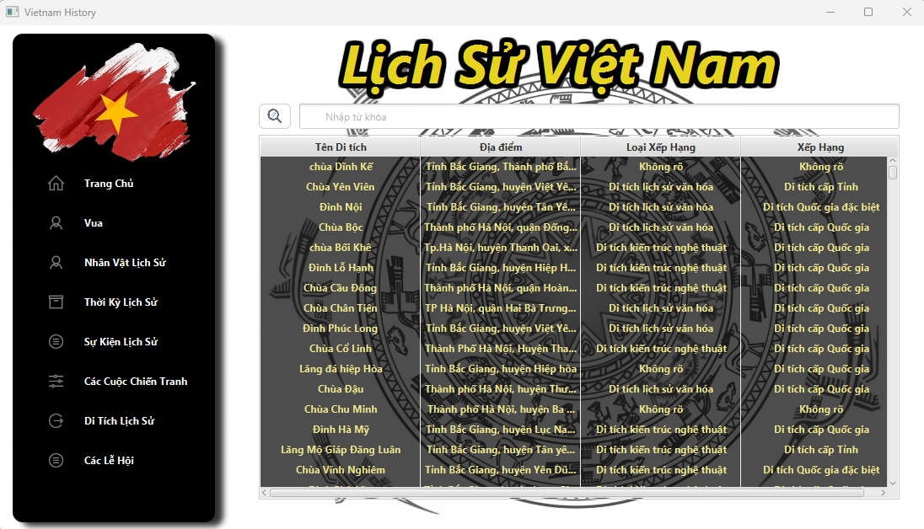
CHAPTER 5. RESULTS & PROGRAM TESTING
II. Final program testing
Relic Screen (Di tích lịch sử)

Slide 38
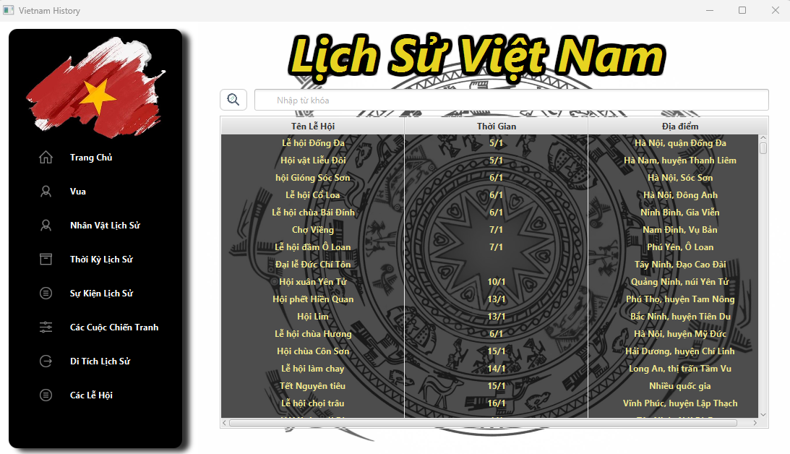
CHAPTER 5. RESULTS & PROGRAM TESTING
II. Final program testing
Festival Screen (Các lễ hội)

Slide 39
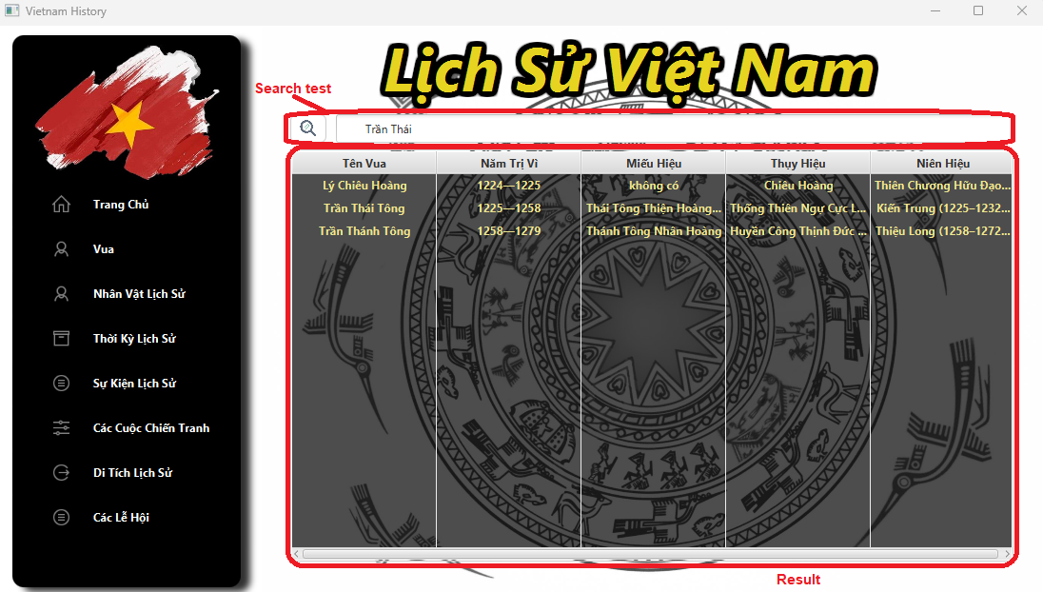
CHAPTER 5. RESULTS & PROGRAM TESTING
II. Final program testing
Search Test

Slide 40
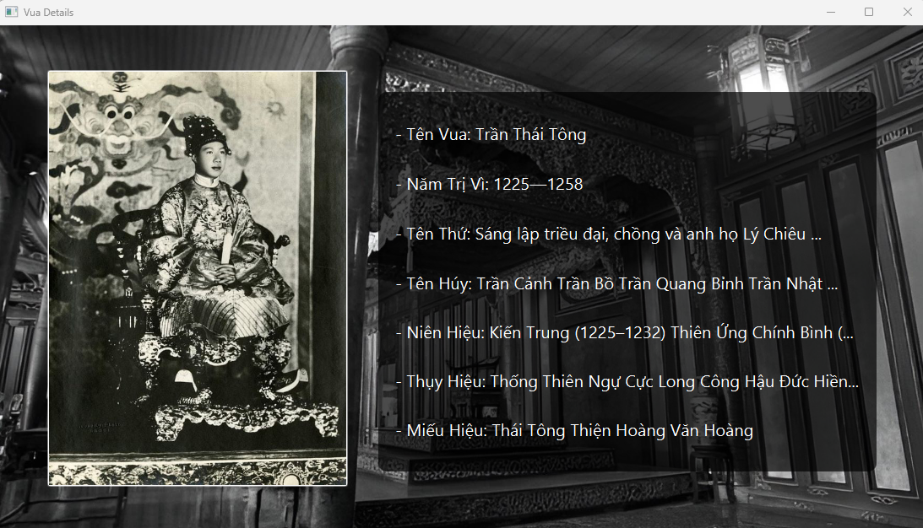
CHAPTER 5. RESULTS & PROGRAM TESTING
II. Final program testing
Details of Kings

Slide 41
CHAPTER 6. OOP TECHNIQUES IN USE
I. OOP Techniques
Encapsulation
Inheritance
Polymorphism
Abstraction
Generic Programming
Low coupling
High Cohesion
II. Algorithms
The keys of the objects are stored in an ArrayList<String> to save memory space and to comfort the searching function. When information needs to be retrieved, a search is performed based on the key to that model

Slide 42
REFERENCES
[1] SOICT, Slides of OOP (IT3100E), Ha Noi: SOICT, HUST, 2023.
[2] ZenRows, "Web Scraping in Java in 2023: The Complete Guide," 19 December 2022. [Online]. Available: https://www.zenrows.com/blog/web-scraping-java#can-you-web-scrape-with-java. [Accessed 2023].
[3] Oracle, "Getting Started with JavaFX," September 2013. [Online]. Available: https://docs.oracle.com/javafx/2/get_started/jfxpub-get_started.pdf. [Accessed June 2023].

Slide 43
Thank You!

